Slide 1

WIPRO NGA Program – Automotive Batch
Capstone Project Presentation – 28th June 2024
Project Title Here – Third Eye Surveillance
Presented by – Hrushikesh Pawar
www.rpsconsulting.in

Slide 2



Third Eye Surveillance System for Vehicles
The Third Eye Surveillance System enhances vehicle security by combining vibration detection, real-time image capture, and instant owner notification to protect your car from theft or vandalism, even when unattended.

Slide 3
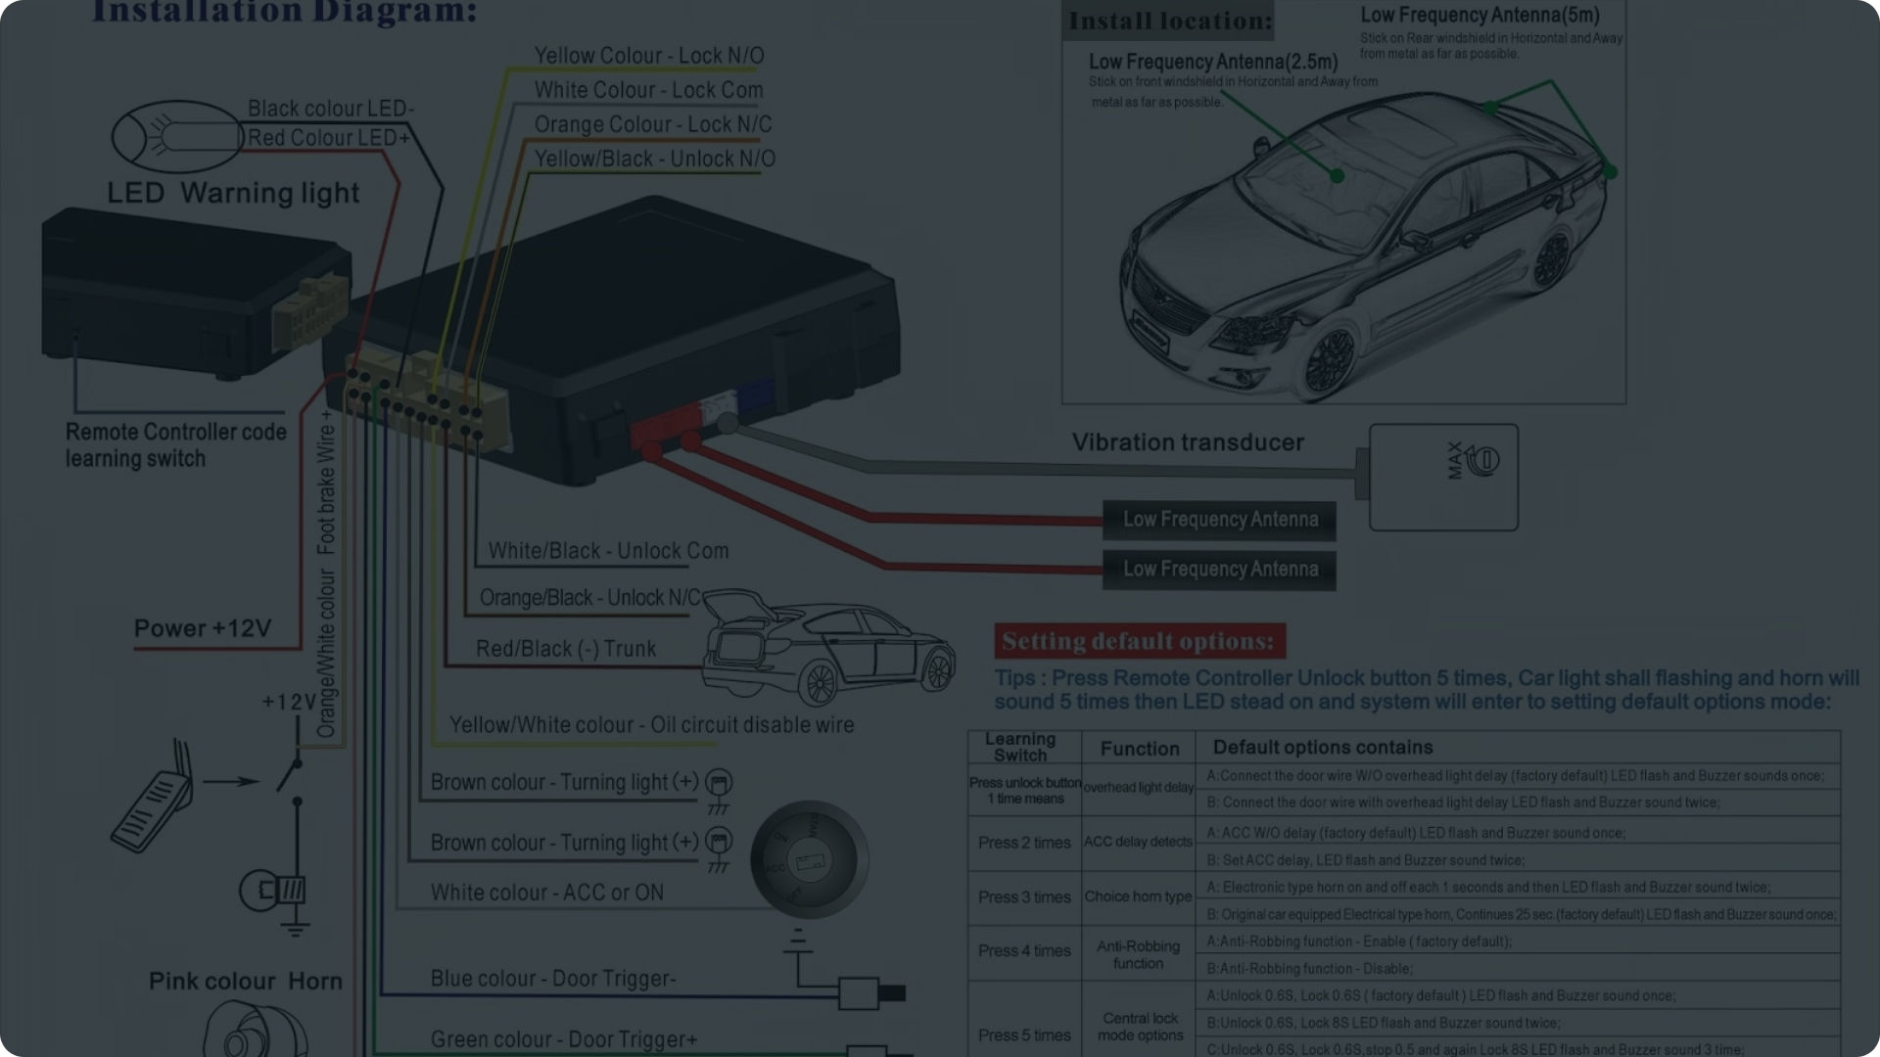
Project Overview
Objective
Motivation
Key Features
Develop a comprehensive surveillance system that detects vibrations, captures and processes images/videos, and notifies the owner in real-time to increase vehicle security.
Prevent theft and vandalism when the vehicle is parked and unattended by providing owners with immediate alerts and visual evidence.
Vibration detection, periodic image capture, image compression, real-time notifications, and a user-friendly interface for viewing alerts and media.

Slide 4

System Architecture
Components:
Technology Stack
Vibration Detector
Camera Module
Image Processor
Storage Manager
Notification System
User Interface.
Accelerometer
image compression algorithms
cloud messaging
A user-friendly mobile app.

Slide 5
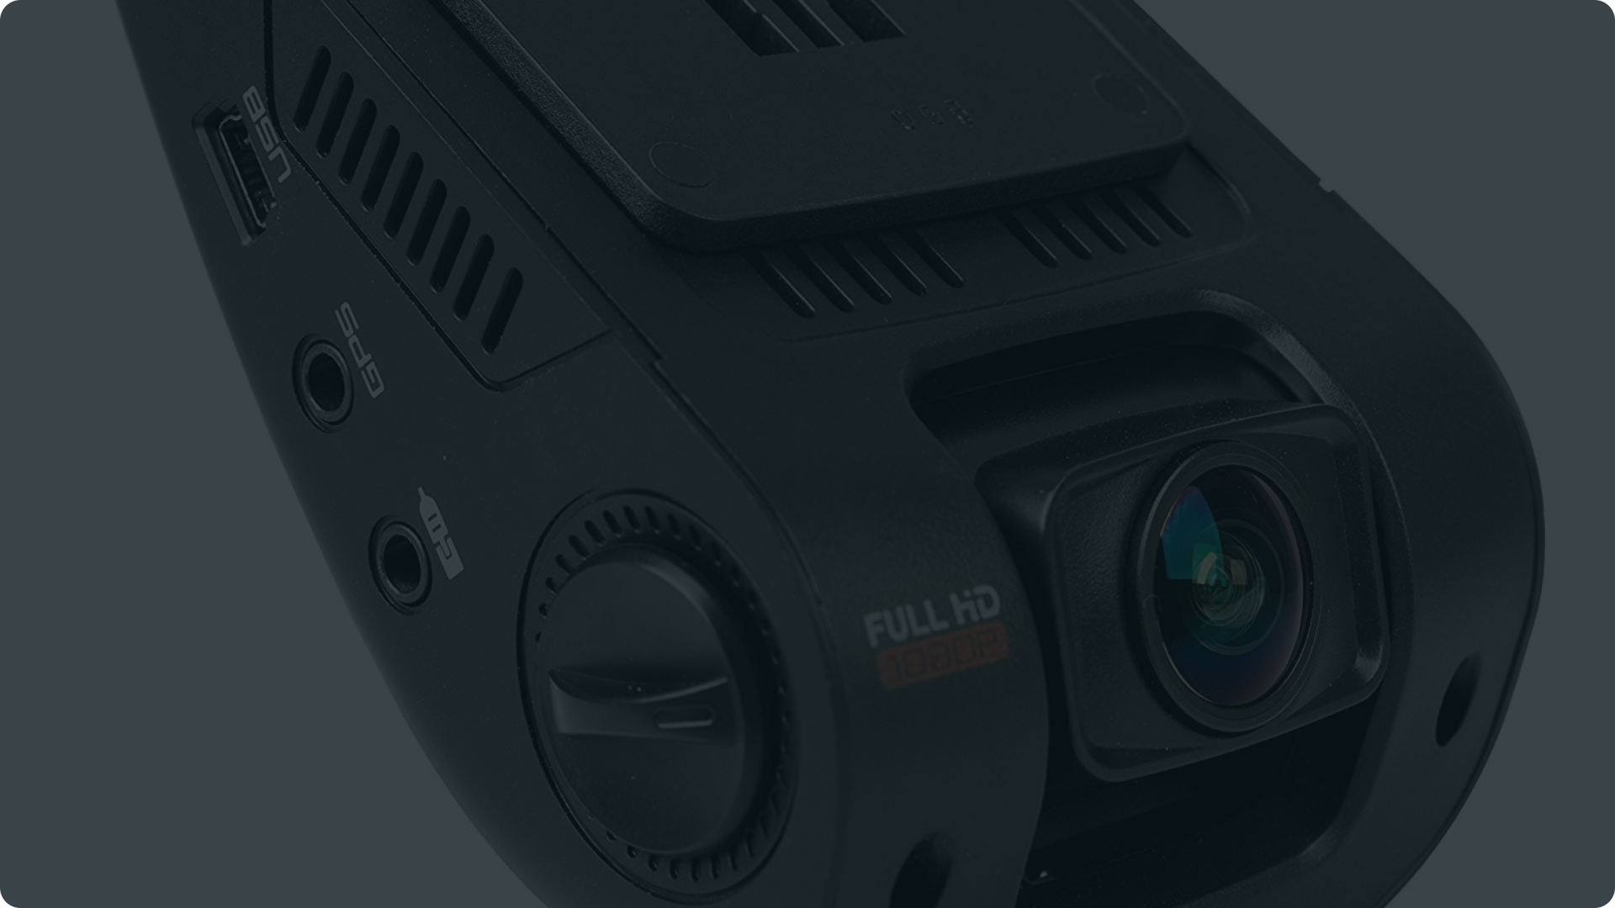
Flow Diagram
Vibration Detection
Image Processing
Notification
1
2
4
5
6
1
3
Camera Capture
Storage
User Interaction

Slide 6
Implementation Details
Vibration Detection
Image Processing
Uses an accelerometer sensor to detect vibrations and trigger the camera.
Compresses captured images to reduce storage space while maintaining high quality.
1
2
3
4
Camera Capture
Storage Management
Captures photos every 2 seconds when vibrations are detected, handling both images and video.
Efficiently manages the local storage to avoid overflow

Slide 7
Real-time Notifications and User Interface
Notifications
User Interface
Uses Firebase Cloud Messaging to send real-time alerts, images, and videos to the owner's smartphone.
The system leverages Firebase Cloud Messaging to deliver real-time alerts to the owner's smartphone. This ensures that owners are promptly notified of any suspicious activities detected by the system, enabling swift action.
Provides a user-friendly app for viewing captured media, accessing real-time alerts, and monitoring the vehicle's security status.
It allows them to view captured media, access real-time alerts, and manage system settings intuitively and effectively.

Slide 8
Testing and Security Compliance
1
Rigorous Testing
2
Security and Privacy
Conducts comprehensive testing under various lighting and weather conditions to ensure system reliability and robustness.
Ensures data capture and transmission are secure, complies with privacy laws, and protects user data from unauthorized access.

Slide 9
Conclusion and Future Work
Conclusion:
In conclusion, the Third Eye Surveillance System represents a significant advancement in vehicle security technology. By combining advanced sensors, real-time monitoring, and user-friendly interfaces, we've created a robust solution to safeguard vehicles against potential threats.
Future Work:
Looking ahead, our focus will be on continuous improvement based on user feedback and technological advancements. This includes further enhancing system capabilities, expanding compatibility, and integrating cutting-edge security features to meet evolving needs.

Slide 10
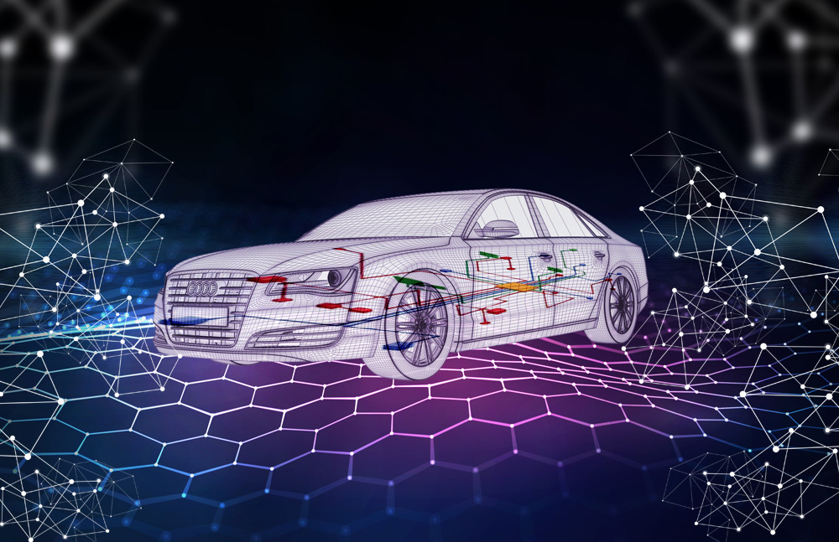
Project Overview :
THANK YOU
2024 - RPS Consulting all rights reserved
Presented by Hrushikesh Pawar

